Slide 1
Effects of Regorafenib Therapy on Health-Related Quality of Life in Patients With Metastatic Colorectal Cancer in the Phase III CONCUR Trial
Abstract 697
Qin S, Kim TW, Yau TC, Ma B, Pan H, Xu JM, Bai Y, Wang L, Y KH, Bi F, Cheng Y, Le TA, Lin JK, Liu T, Dong M, Kappeler C, Chang J, Xu RH, Li J, on behalf of CONCUR investigators

Slide 2

Background
Regorafenib (REG) is an oral multikinase inhibitor that blocks the activity of multiple protein kinases that are involved in the regulation of angoigenesis, oncogenesis, and the tumor microenvironment
Two phase III trials have shown that regorafenib significantly improves overall survival (OS) versus placebo (PBO) in patients with mCRC whose disease had progressed on standard treatments
CONCUR: HR 0.55 (95% CI 0.40-0.77; P = .0002¹
CORRECT: HR 0.77 (95% CI 0.64-0.94; P = .0052)²
The objective of this current study is to report the effects of regorafenib on health-related quality of life (HRQoL) in patients enrolled in the CONCUR trial
1. Grothey A, et al. Lancet. 2013;381:303-312. 2. Li Q, et al. Ann Oncol. 2014;25(Suppl 2): Abstract O-0023.
Qin S, et al. J Clin Oncol. 2015;33(suppl 3): Abstract 697.

Slide 3
Trial Design
Regorafenib (160 mg daily)
3 weeks on/1 week off
(4-week cycle)
N = 136
Asian patients with mCRC who progressed after standard therapies
25 centers: Mainland China, Hong Kong, South Korea, Taiwan, Vietnam
R
2:1
Stratification
Metastases: Single vs multiple
Time from mCRC diagnosis: >18 months vs <18 months
Placebo
N = 68
Primary endpoint: OS
Secondary endpoints: Progression-free survival (PFS), response rate, disease control rate (DCR)
All patients received BSC
Treat until progression, unacceptable toxicity, or withdrawal
Qin S, et al. J Clin Oncol. 2015;33(suppl 3): Abstract 697.

Slide 4
Key Inclusion Criteria
Pathologically proven mCRC
Measurable or nonmeasurable disease (RECIST v1.1)
Failed ≥2 prior CRC treatment regimens, which included a fluoropyrimidine, oxaliplatin, and irinotecan
Progression during or within 3 months after the last approved standard therapy or during or within 6 months of completing adjuvant oxaliplatin-based therapy
Prior anti-VEGF or anti-EGFR targeted therapy allowed, but not mandatory
ECOG performance status 0 or 1
ECOG, Eastern Cooperative Oncology Group
Qin S, et al. J Clin Oncol. 2015;33(suppl 3): Abstract 697.

Slide 5
HRQoL Assessment
HRQoL was assessed in all 204 patients in prespecified analyses using the European Organization for Research and Treatment of Cancer Quality of Life Questionnaire (EORTC QLQ-C30) and the Euro-QoL five dimension questionnaire (EQ-5D) index and visual analog scale (VAS)
HRQoL outcomes were expressed as least squares mean (LSM) time-adjusted area under the curve (AUC) to allow descriptive evaluation of HRQoL for both REG and PBO groups across the entire treatment period
Longitudinal change from baseline in scores on individual domains were also compared using descriptive statistics
For both domains, higher scores represent better quality of life; a change in score of 10 points was considered the minimal clinically important difference
Qin S, et al. J Clin Oncol. 2015;33(suppl 3): Abstract 697.

Slide 6
LSM Time-Adjusted AUC of HRQoL Scales
LSM Time-Adjusted AUC (95% CI) | Reg (n = 131) | PBO (n = 63)
EORTC QLQ-C30 global health status | 60.76 (58.81 to 62.71) | 61.16 (58.48 to 63.83)
Difference from placebo | -0.40 (-3.53 to 2.72)
EQ-5D index | 0.70 (0.67 to 0.73) | 0.74 (0.70 to 0.78)
Difference from placebo | -0.03 (-0.08 to 0.01)
EQ-5D VAS | 69.28 (67.48 to 71.08) | 70.46 (68.01 to 72.91)
Difference from placebo | -1.18 (-4.01 to 1.66)
Qin S, et al. J Clin Oncol. 2015;33(suppl 3): Abstract 697.

Slide 7
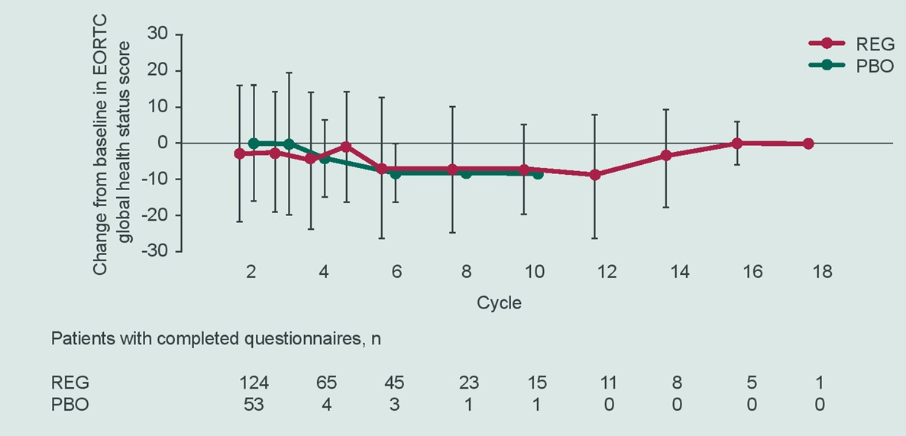
EORTC QLQ-C30 Global Health Status
Qin S, et al. J Clin Oncol. 2015;33(suppl 3): Abstract 697.

Slide 8
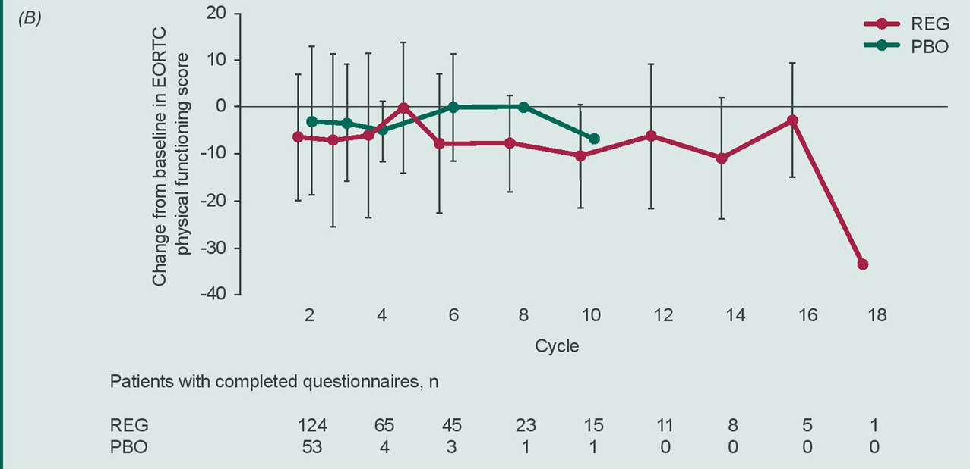
EORTC QLQ-C30 Physical Function Scores
Qin S, et al. J Clin Oncol. 2015;33(suppl 3): Abstract 697.

Slide 9
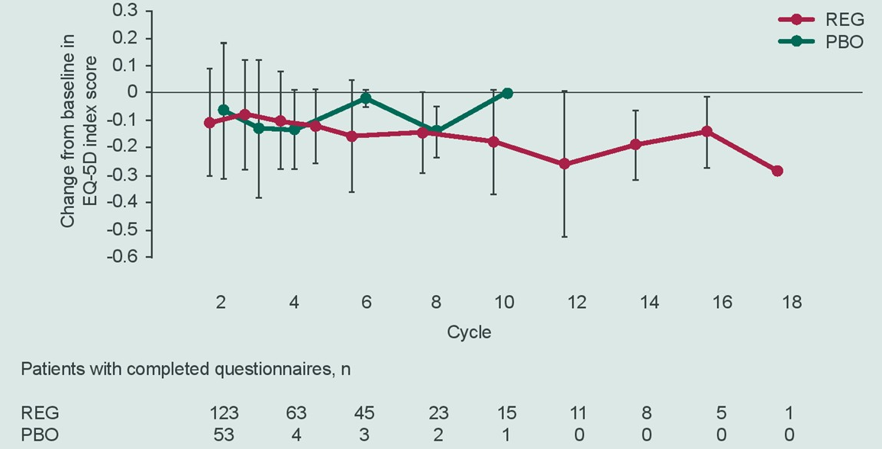
EQ-5D Index
Qin S, et al. J Clin Oncol. 2015;33(suppl 3): Abstract 697.

Slide 10
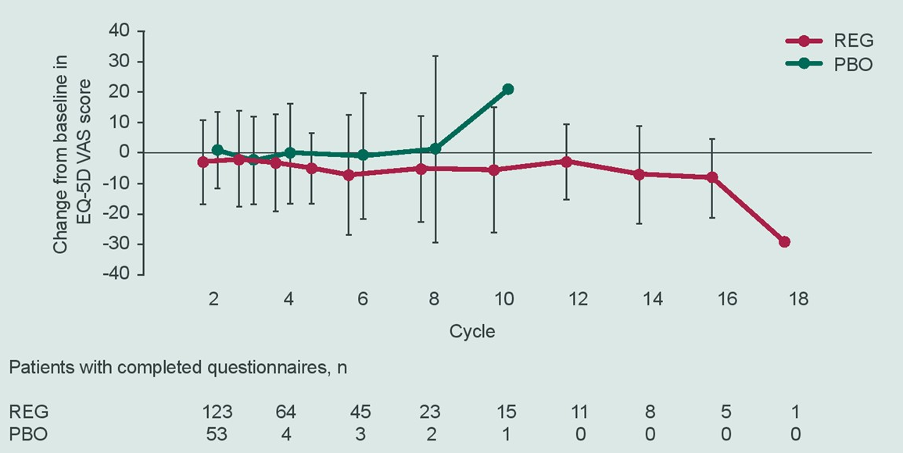
EQ-5D VAS Scores
Qin S, et al. J Clin Oncol. 2015;33(suppl 3): Abstract 697.

Slide 11
Conclusions
HRQoL did not appear to differ in REG-treated patients compared with PBO recipients, as assessed by LSM time-adjusted AUC of EORTC global health status scores and EQ-5D index and VAS scores
Longitudinal changes from baseline in EORTC QLQ-C30 global health status and physical functioning scores and EQ-5D index and VAS scores appeared generally similar in the REG and PBO groups
EORTC QLQ-C30 global health status and physical functioning appeared to be reduced from baseline in both the REG and PBO groups
These findings indicate that REG significantly prolongs survival while maintaining comparable HRQoL versus PBO in Asian patients with mCRC, consistent with findings from the global CORRECT trial
Qin S, et al. J Clin Oncol. 2015;33(suppl 3): Abstract 697.

